Slide 1
Visualización de redes bipartitas con BipartGraph
Javier García Algarra
U-tad
Septiembre de 2020

Slide 2
Van un ecólogo, un físico y un ingeniero…

Slide 3
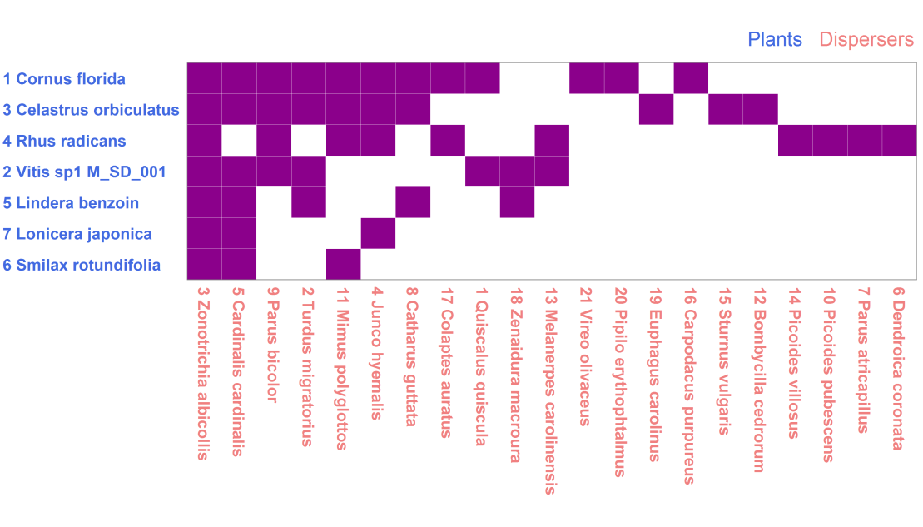
Muchas redes biológicas son bipartitas
Gráfico bipartito de una red de polinizadores y plantas
Matriz de adyacencia de una red de plantas y frugívoros
Notes:
Bipartite networks are very common in biology, we find them in ecology, genomics and biochemistry as well. There are two classical plots for bipartite netwworks, the bipartite plot and the adjacency matrix. Here we have two examples.

Slide 4
Estos gráficos son difíciles de leer con un número de nodos y enlaces de unas pocas decenas
Red mutualista con 78 nodos
Notes:
This is a simple bipartite networks but it is hard to read it.

Slide 5
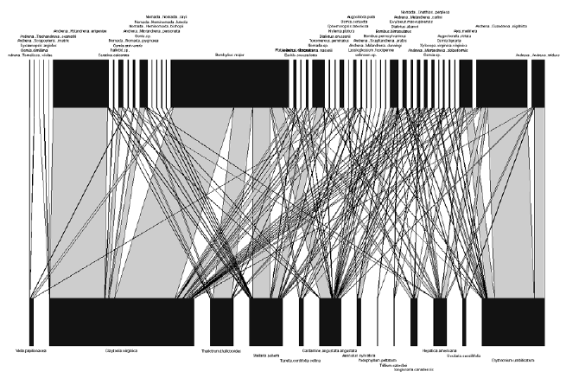
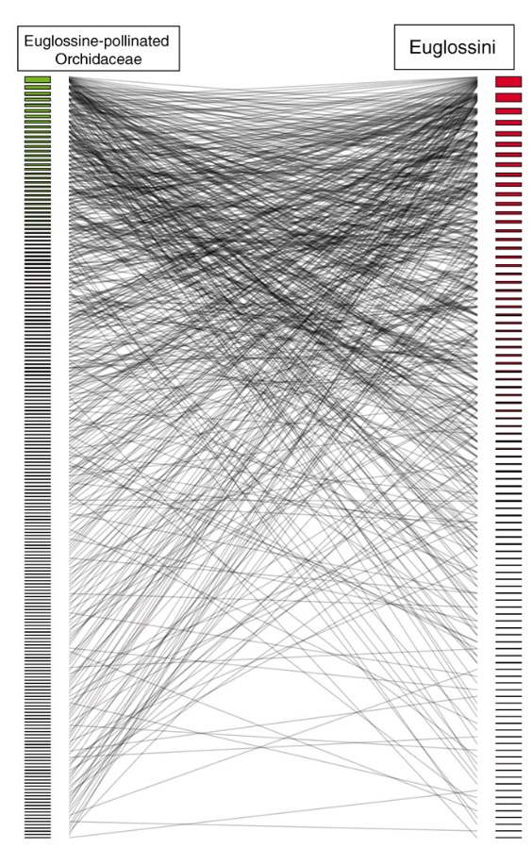
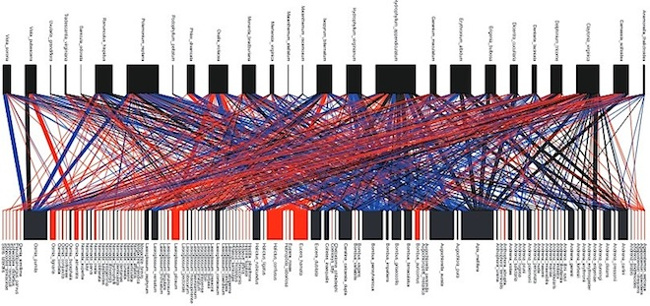
Estos gráficos son difíciles de leer con un número de nodos y enlaces de unas pocas decenas
Notes:
These are three examples of the literature showing what is called the hairball effect. There is an isssue with the ability of the human eye to deal with so many lines.

Slide 6
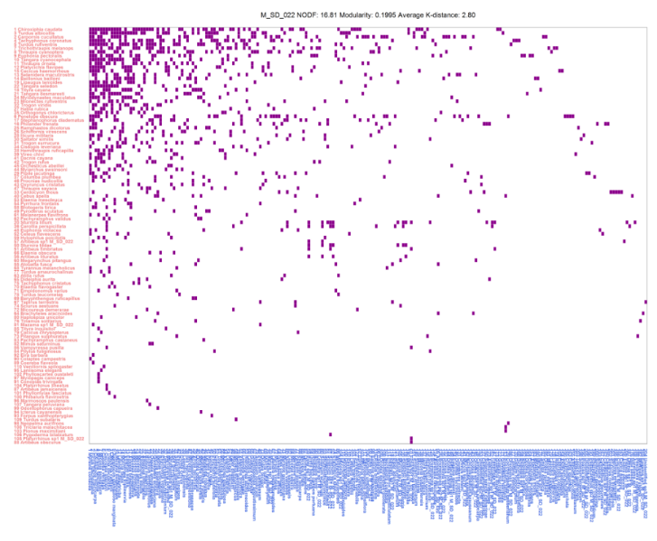
Estos gráficos son difíciles de leer con un número de nodos y enlaces de unas pocas decenas

Slide 7
Sabemos que las interacciones bióticas muestran una propiedad estructural que puede ser útil para diseñar nuevas visualizaciones
Núcleo
Periferia
Notes:
Our starting point is the common observation that many bipartite biotic networks have a clear core periphery structure. What if we could spatially organize the plot according to this property?

Slide 8
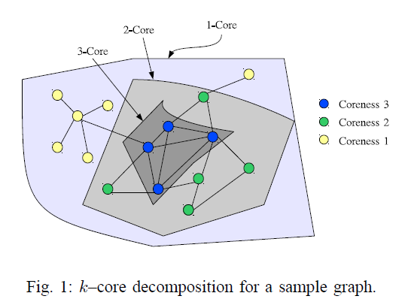
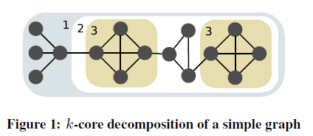
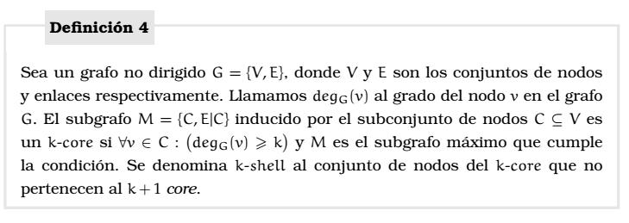
Descomposición k-core
Notes:
To achieve this goal we use te k-core decomposition. This is an example of the pruning algorithm. First we remove links that have one of their edges in a node with just one link. When we finish the isolates nodes are the 1 Shell. We continue removing two links and finally three. Ths highest k index of this network is 3 and those nodes are the innermost Shell. It provides stability to the network.

Slide 9
Descomposición k-core
2-Shell
1-Shell
3-Shell
1
2
3
4
5
6
7
8
1
2
3
4
5
6
7
Notes:
To achieve this goal we use te k-core decomposition. This is an example of the pruning algorithm. First we remove links that have one of their edges in a node with just one link. When we finish the isolates nodes are the 1 Shell. We continue removing two links and finally three. Ths highest k index of this network is 3 and those nodes are the innermost Shell. It provides stability to the network.

Slide 10
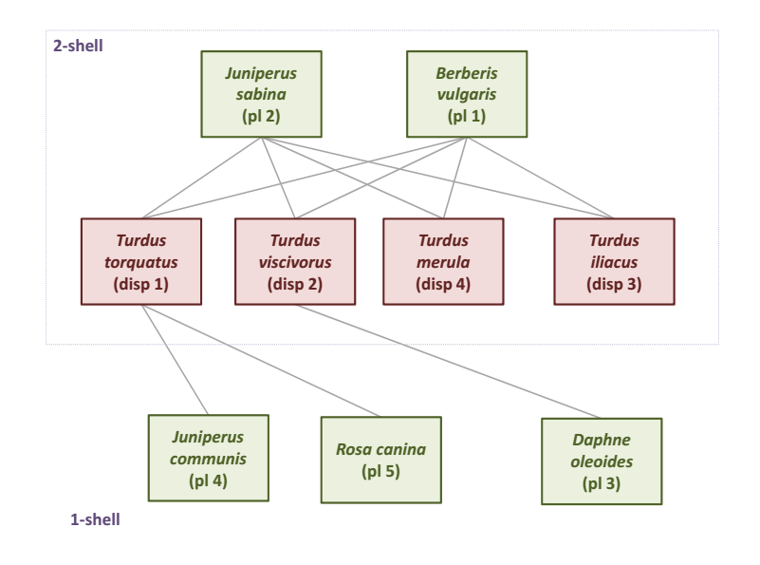
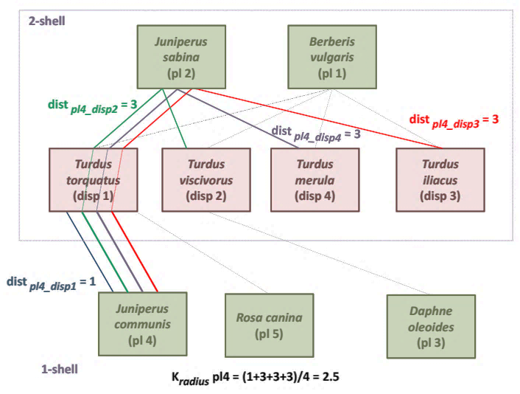
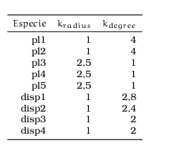
k_{radius}
El k_{radius} del nodo m de la clase A es la distancia media a todos los nodos de la Shell de índice máximo de la clase B

Slide 11
k_{degree}
El k_{degree} de un nodo m es la suma de los inversos de los k_{radius} de todos los nodos con los que se conecta.
Notes:
K degree is a connetivity measure

Slide 12
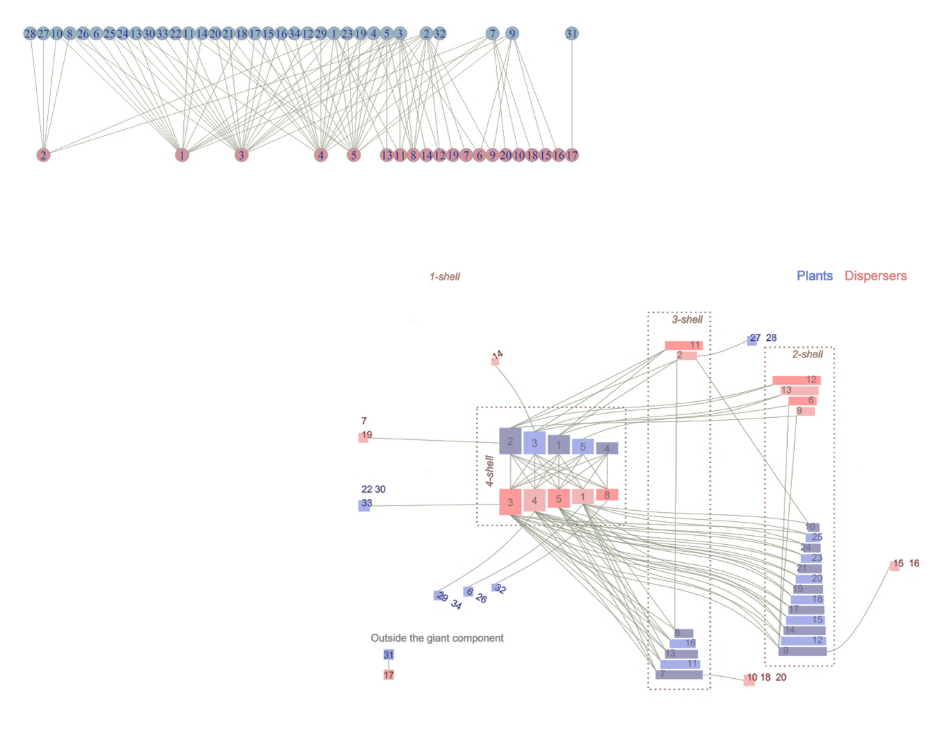
Con estas medidas creamos un nuevo gráfico, el diagrama zigurat
Esto permite tener una visión mucho más rica de la estructura interna de la red
Notes:
Using the k parameters we build the ziggurat plot goin

Slide 13
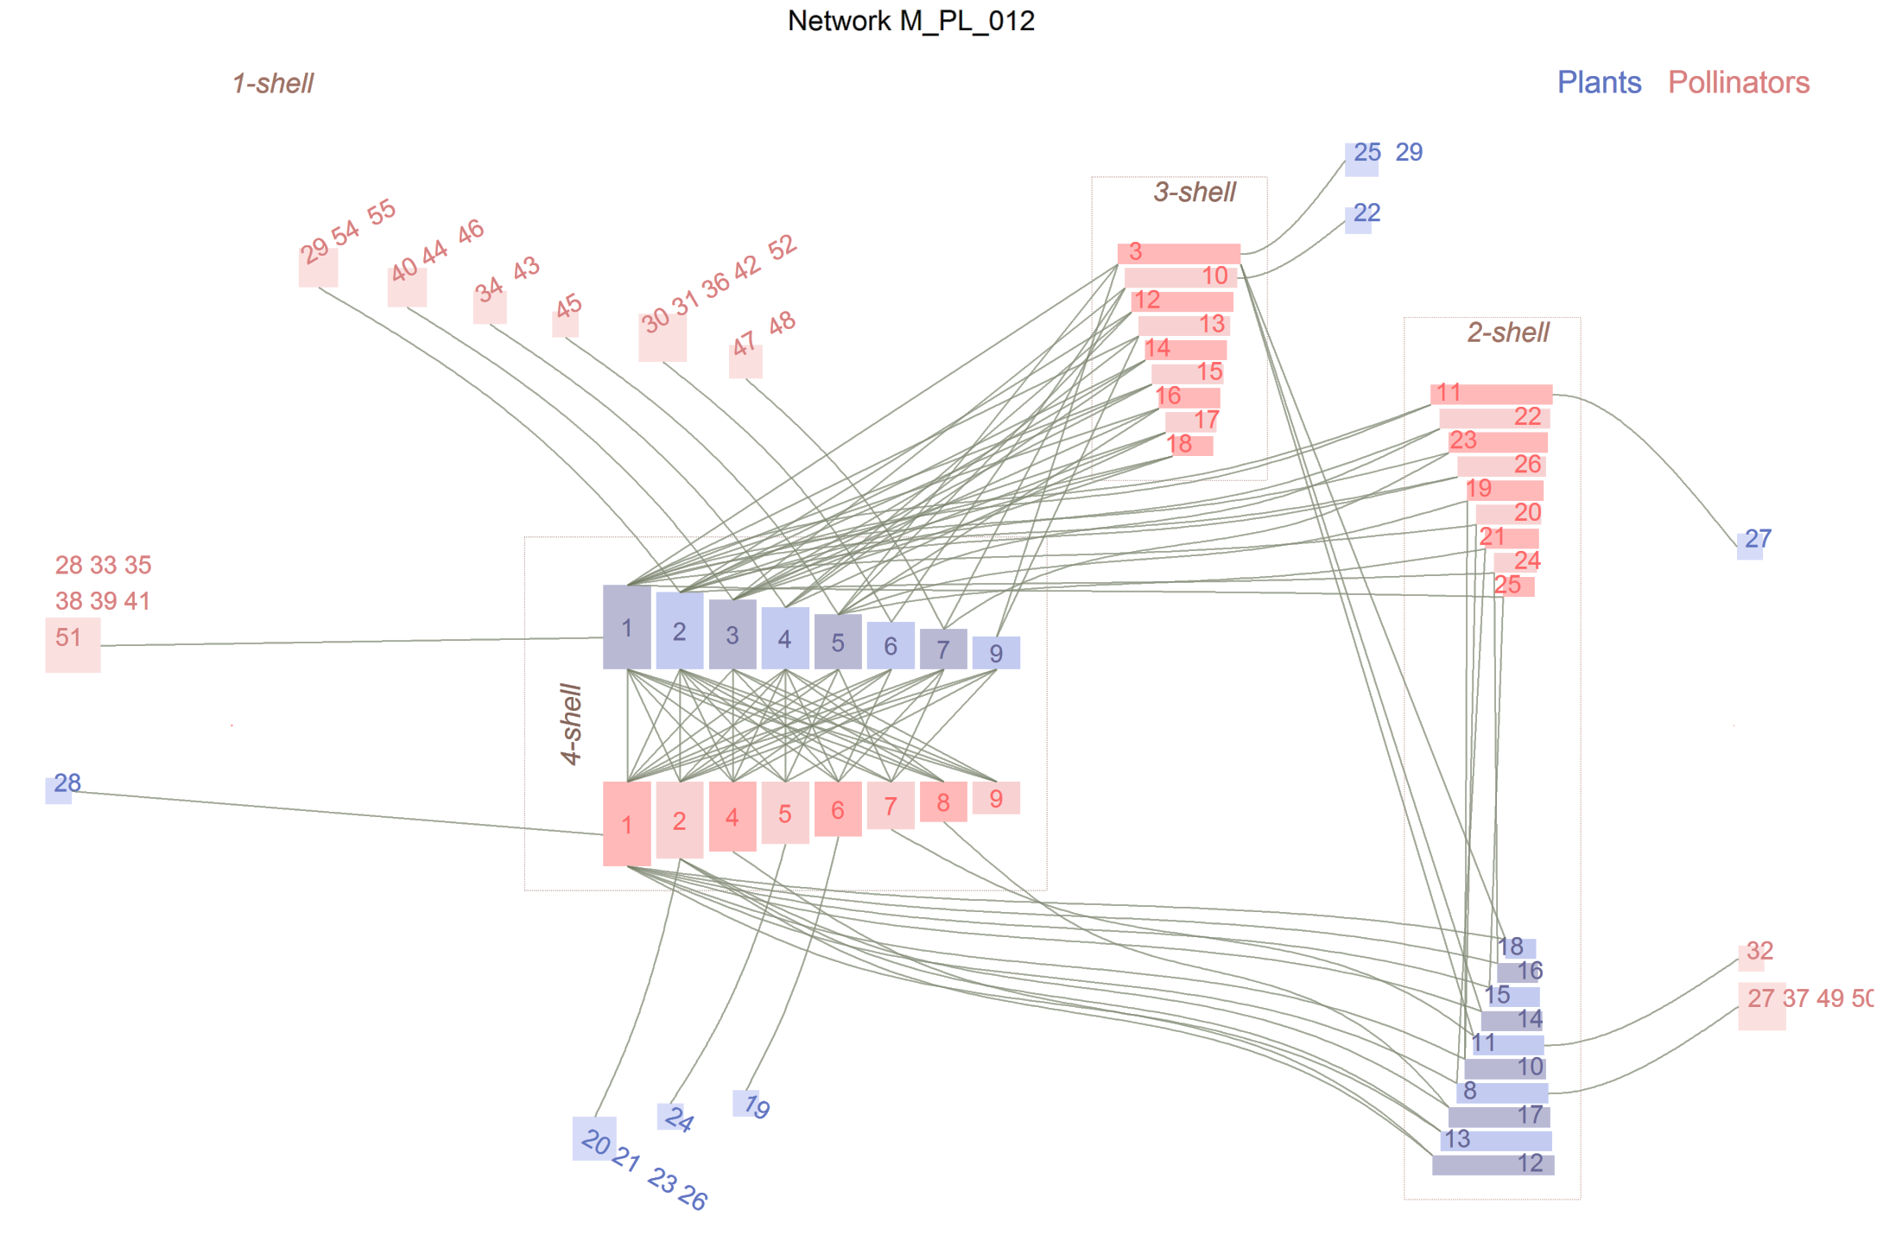
El espacio se organiza de acuerdo a las k-shells con la Shell de k máxima en el centro
Centralidad
Connectividad
El espacio central libre con forma de almendra permite trazar los enlaces
Las especies de la 1-Shell pueden estar representadas en un único nodo
Connectividad
Centralidad

Slide 14
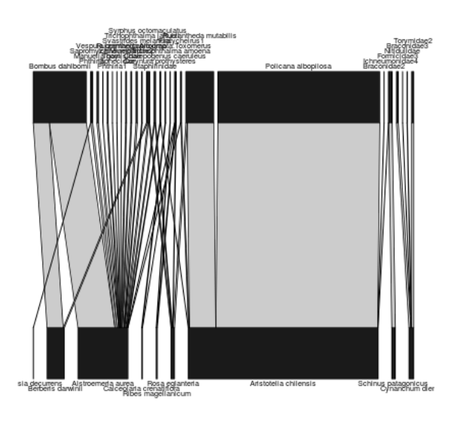
¿Conoces esta red?
Safariland, el ejemplo del paquete R bipartite

Slide 15
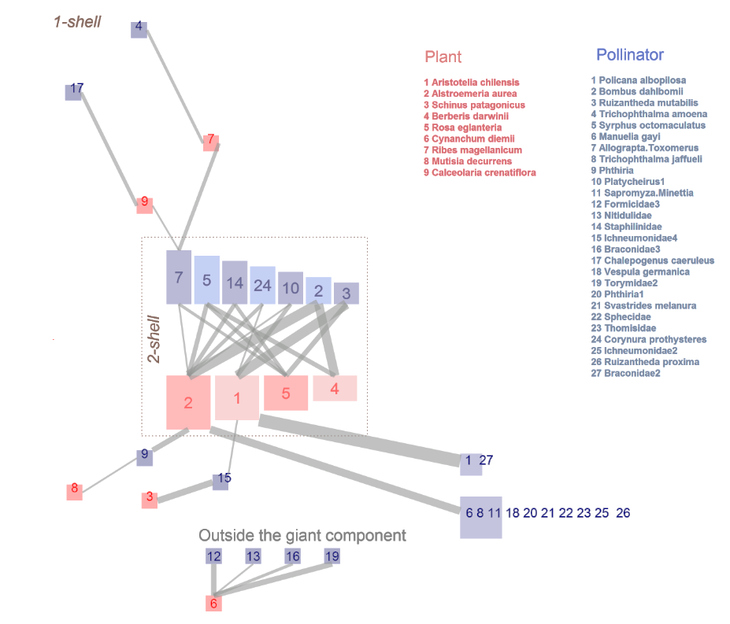
El diagrama zigurat de la misma red
Notes:
This is the zigurat of the same newtork. Now you can understand why plant number 2 is so important. On the other guild, pollinator number 7 is the innermost of te newtork, in the bipartite plot you can’t even discover it. An interesting detail is the subnetwork detached from the giant component.

Slide 16
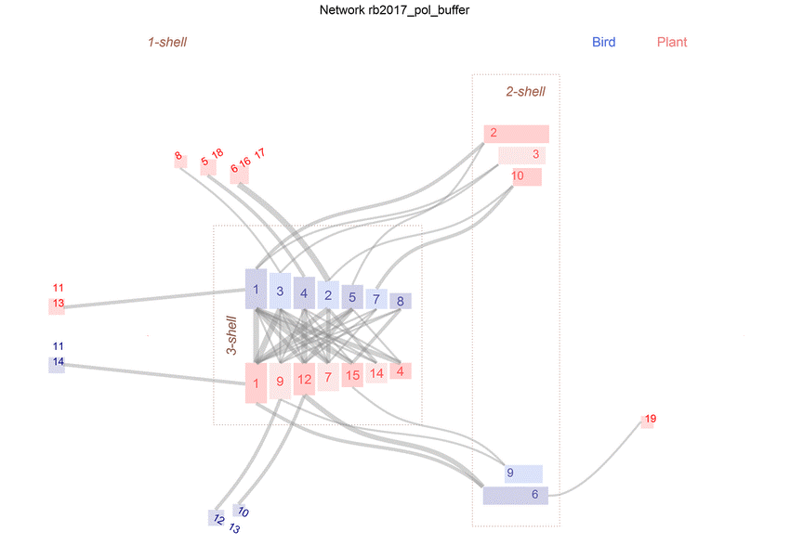
Las redes son variadas y muy hermosas
Ramírez Burbano et al: The role of the endemic and critically endangered Colorful Puffleg Eriocnemis mirabilis in plant-hummingbird networks of the Colombian Andes. May 2017 Biotropica 49(4)
Notes:
A nice example of plant pollinator network, quite symmetrical with some specialists

Slide 17
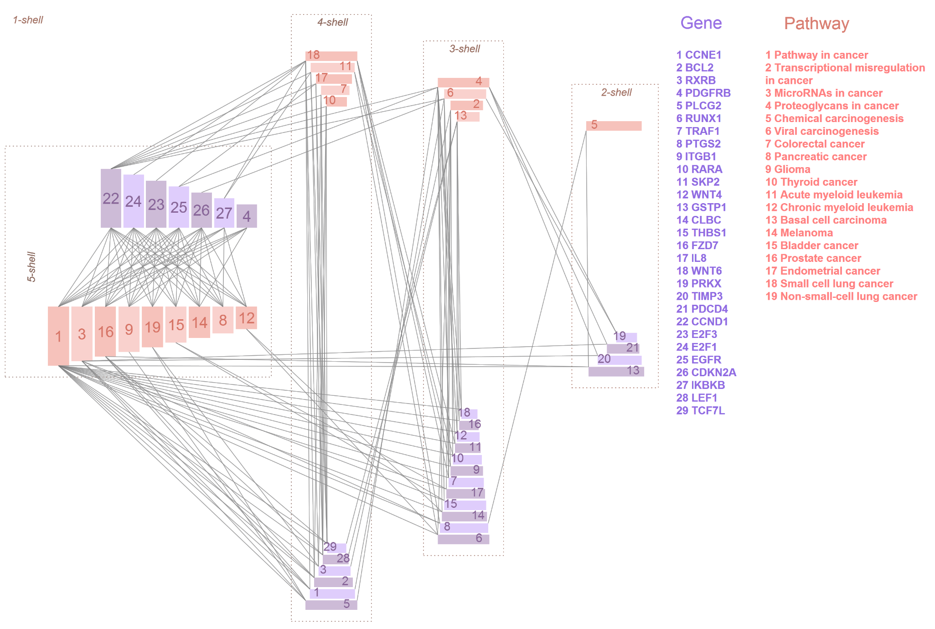
Las redes son variadas y muy hermosas
L. He, Y. Wang, Y. Yang, L. Huang, and Z. Wen, “Identifying
the gene signatures from gene-pathway bipartite network guarantees the robust model performance on predicting the cáncer prognosis,” BioMed Research International, vol. 2014.
Notes:
A very different network of gene pathway signatures with strong internal structure and no specialists

Slide 18
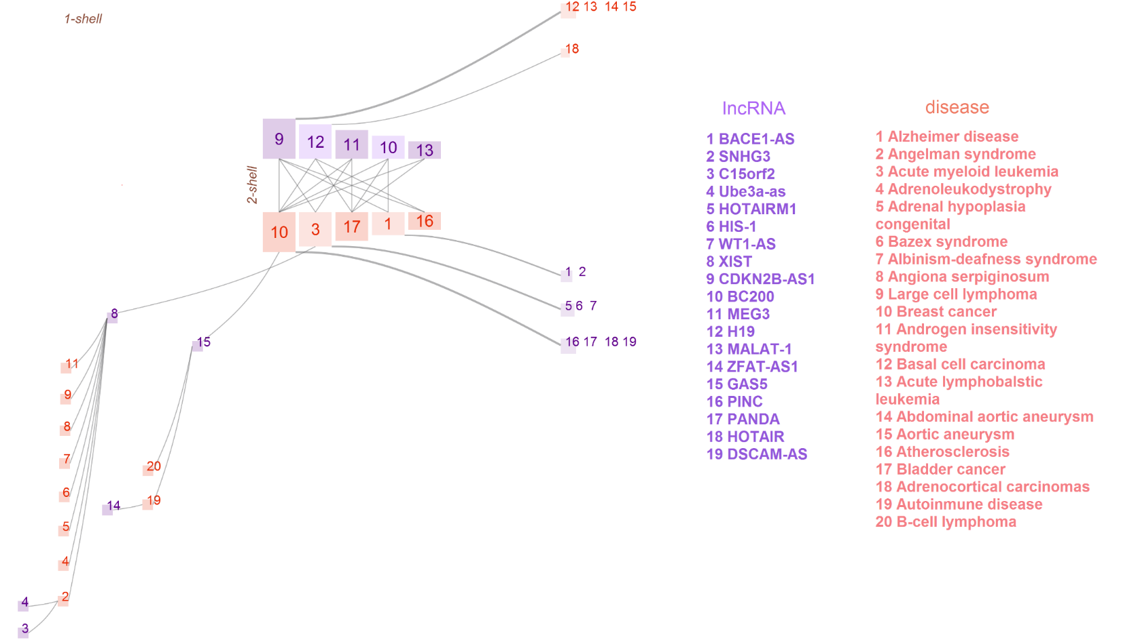
Las redes son variadas y muy hermosas
X. Yang, L. Gao, X. Guo et al., “A network based method for analysis of lncRNA-disease associations and prediction of lncRNAs implicated in diseases,” PLoS ONE, vol. 9, no. 1
Notes:
On the other hand an IncRNA-disease association network with quite rich tails

Slide 19
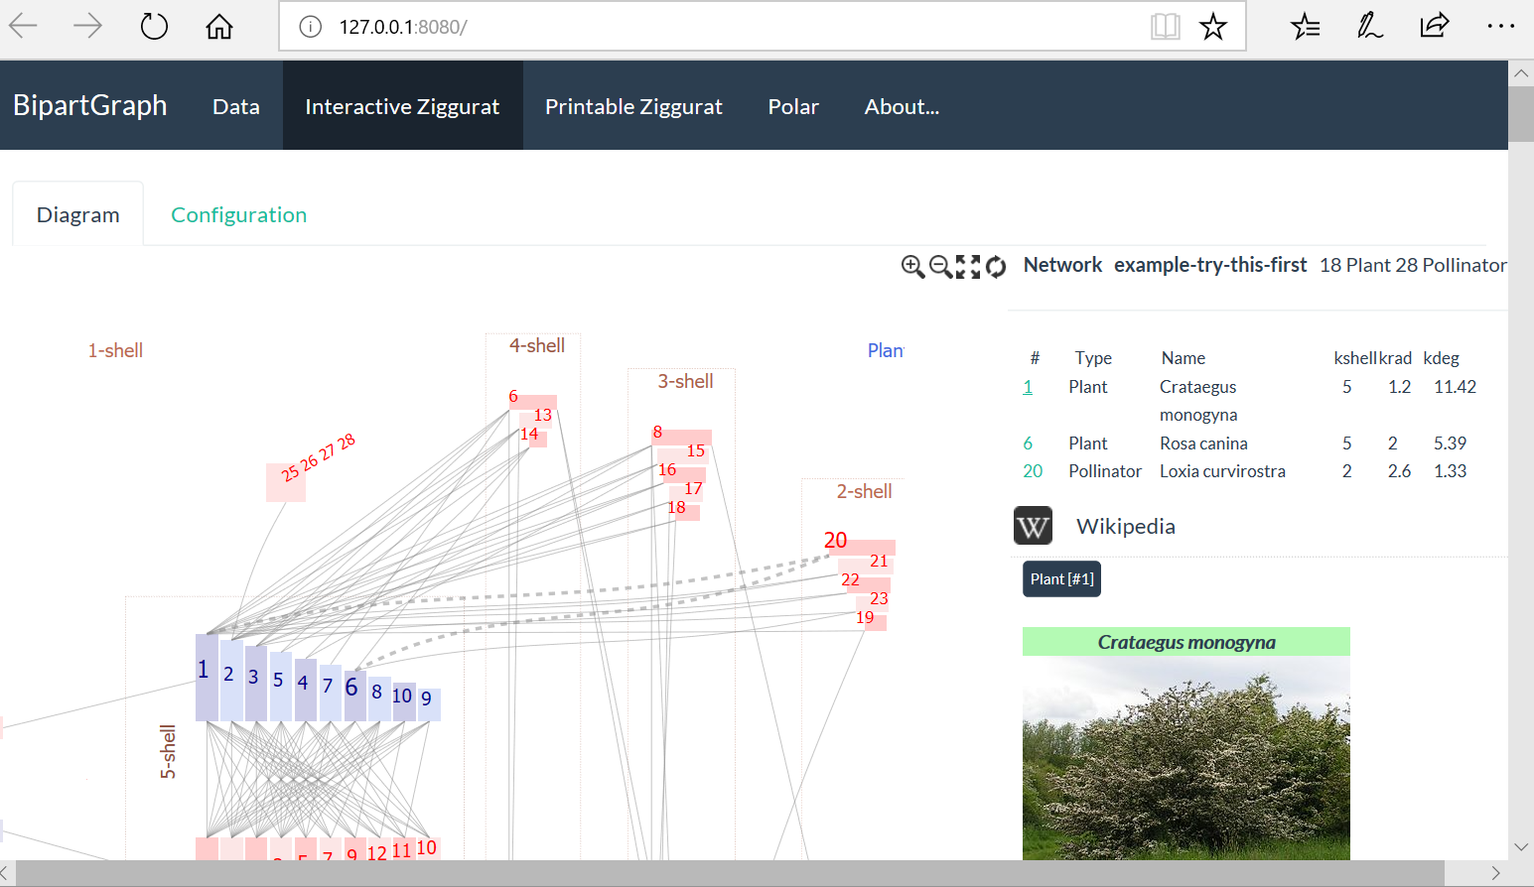
BipartGraph, la aplicación interactiva desarrollada en R para construir estos gráficos
https://github.com/jgalgarra/bipartgraph
http://aleph-tech.io:3838/bipartgraph
Notes:
We developed an interactive, very easy to use applicaction BipartGraph.

Slide 20
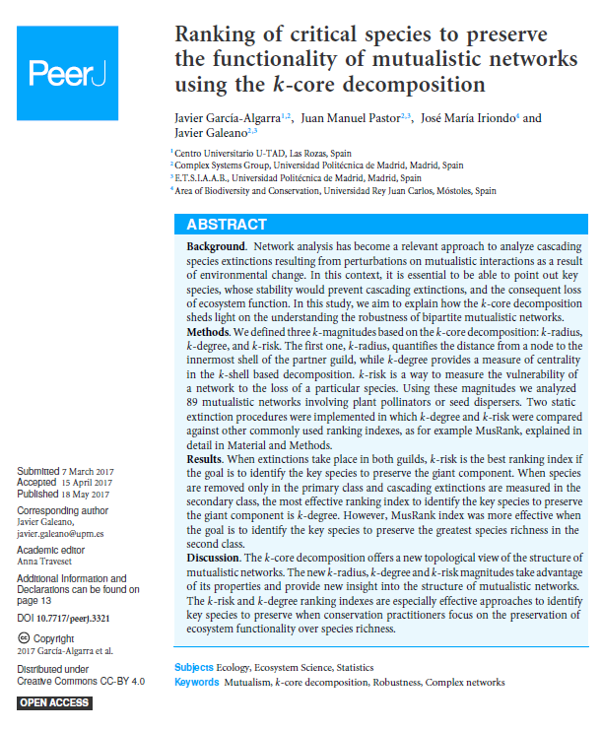
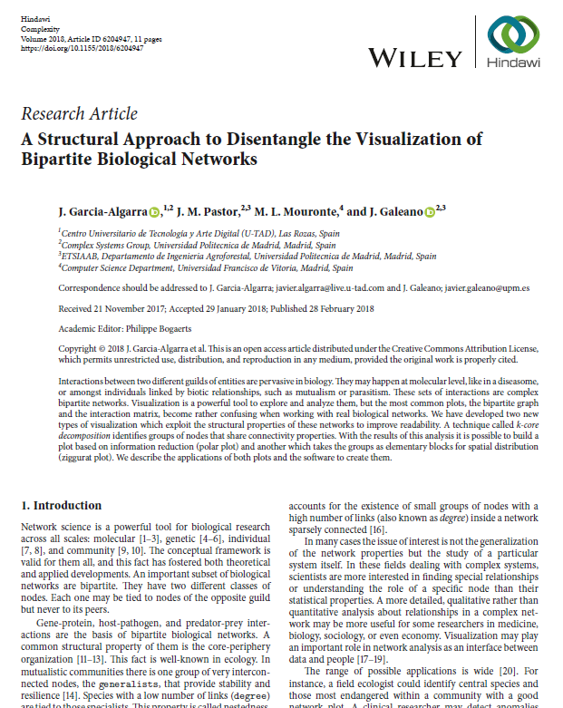
Literatura
García-Algarra, J., Pastor, J. M., Iriondo, J. M., & Galeano, J. (2017). Ranking of critical species to preserve the functionality of mutualistic networks using the k-core decomposition. PeerJ, 5, e3321.
Garcia-Algarra, J., Pastor, J. M., Mouronte, M. L., & Galeano, J. (2018). A structural approach to disentangle the visualization of bipartite biological networks. Complexity, 2018.
Notes:
Finally we have published thess two papers, he first one with the rationale of the usefulness of the kcore decomposition, and the second one describing the BipartGraph application.

